Slide 1
Classification Algorithms in scope for this course
Srikanth Gunturu
Guest Faculty
BITS, WILP

Slide 2
In this segment
Classification Algorithms in scope for this course
K-Nearest Neighbor
Naïve Bayes
Logistic Regression
Decision Tree
Support Vector Machines
Ensemble Methods

Slide 3
Classification Algorithms in scope for this course
k-Nearest Neighbour Classifier (kNN)
Instance based classification
An object is assigned to the class most common among its k nearest neighbours
How to determine optimal k ?

Slide 4
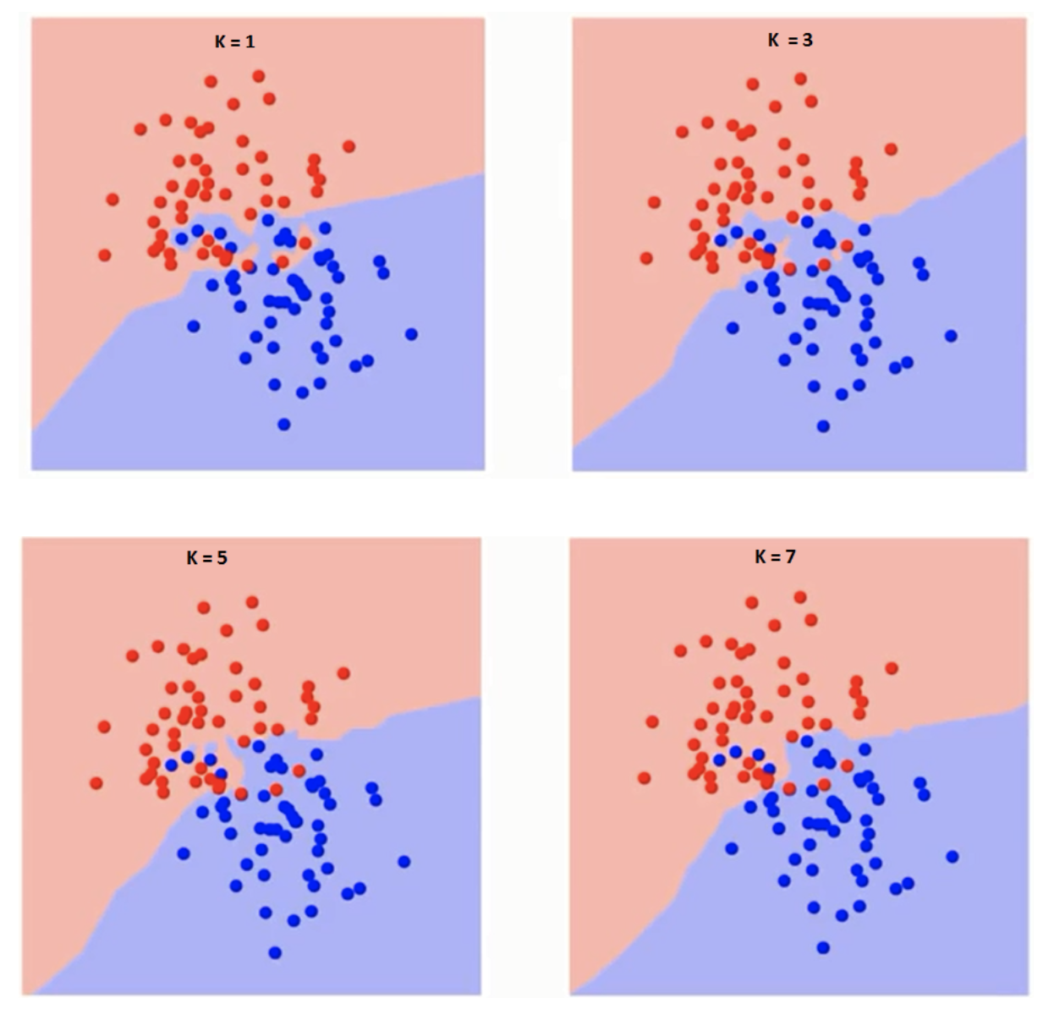
Classification Algorithms in scope for this course
k-Nearest Neighbour Classifier (kNN)
As k increases boundaries get smoother, but..

Slide 5
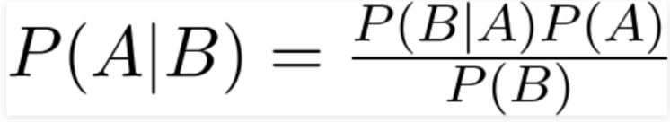
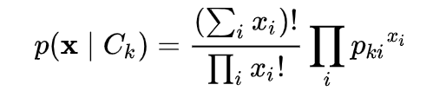
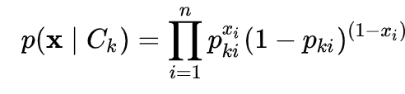
Classification Algorithms in scope for this course
Naïve Bayes Classifier
Bayes Theorem
Naïve Bayes Classifier
Gaussian Naïve Bayes – continuous data
Multinomial Naïve Bayes – feature vector representing frequency
Bernoulli Naïve Bayer – Binary valued features

Slide 6
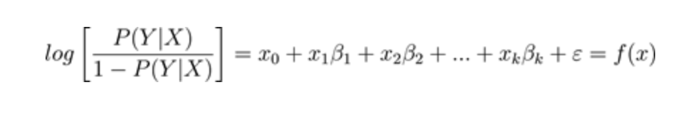
Classification Algorithms in scope for this course
Logistic Regression
Why “regression” for classification ?
Logistic regression (logit) minimizes uncertainties, with differentiable decision function
Posterior probability – log of odds

Slide 7
Classification Algorithms in scope for this course
Decision Tree
Leaf represents class label
Decisions are (internal) nodes/ branches
Supervised learning for classification / regression
Can handle categorical and continuous data
Little preprocessing needed
Prone to overfitting
Pruning
Early stop of tree building

Slide 8
Classification Algorithms in scope for this course
Support Vector Machines (SVM)
Maximum margin classifier – does it work always ?

Slide 9
Classification Algorithms in scope for this course
Support Vector Machines (SVM) – Linear classifier
Support Vector classifier – makes things better but not always
Hard-margin
Soft-margin

Slide 10
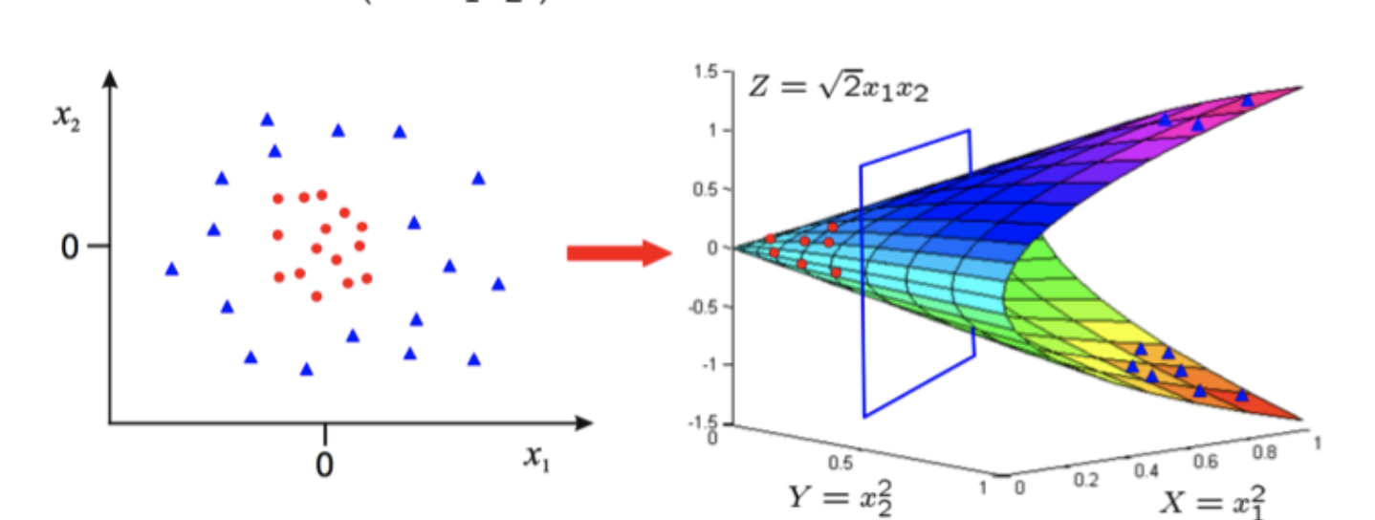
Classification Algorithms in scope for this course
Support Vector Machines (SVM) – Non-linear classifier (kernel trick)
Transforms the feature space to allow fitment of a linear hyperplane
Polynomial
Radial basis function (rbf)
Hyperbolic Tangent (tanh)

Slide 11
Classification
Ensemble Methods
Bagging (Bootstrap AGGregating)
Boosting
AdaBoost (Adaptive Boosting)
XGBoost (eXtreme Gradient Boosting)
Random Forest

Slide 12
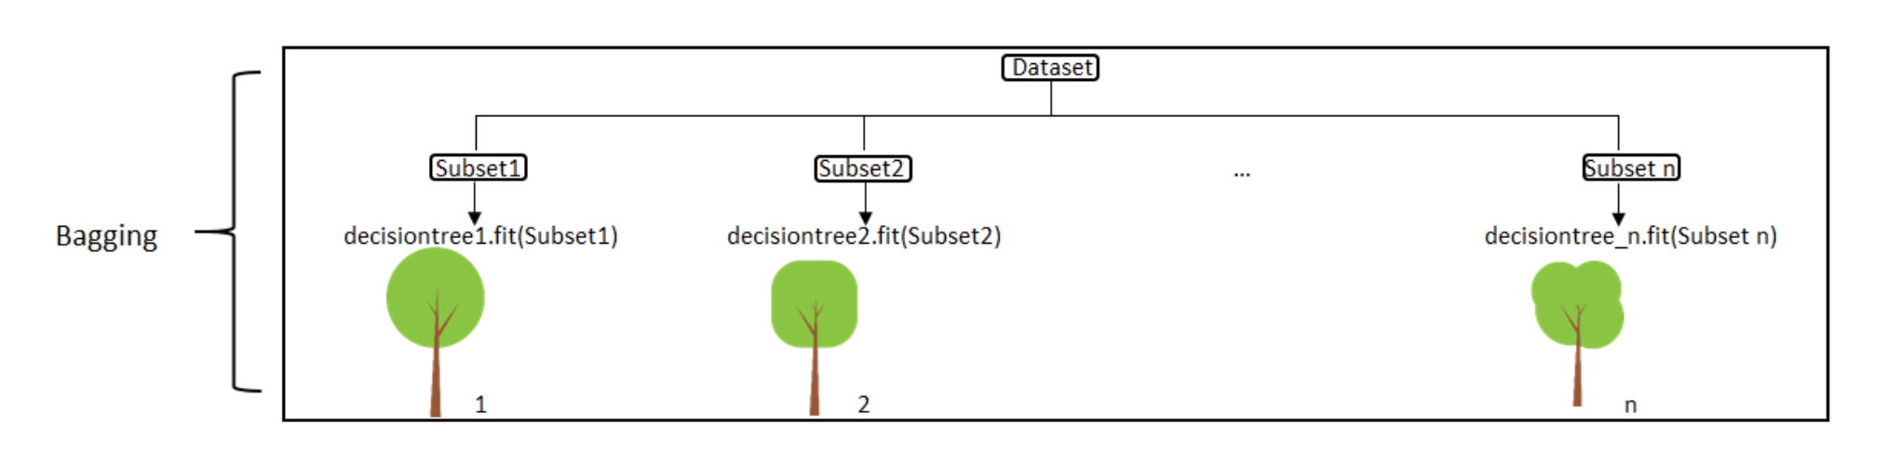
Classification
Bagging

Slide 13
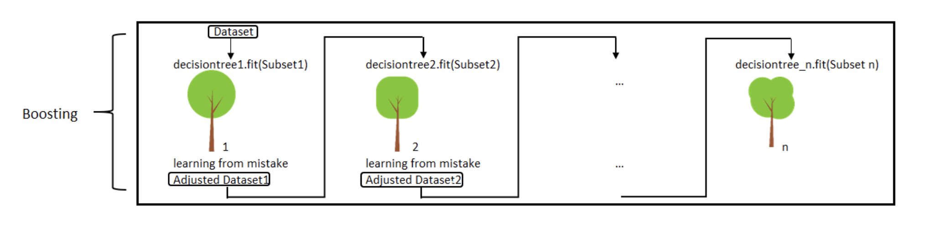
Classification
Boosting

Slide 14
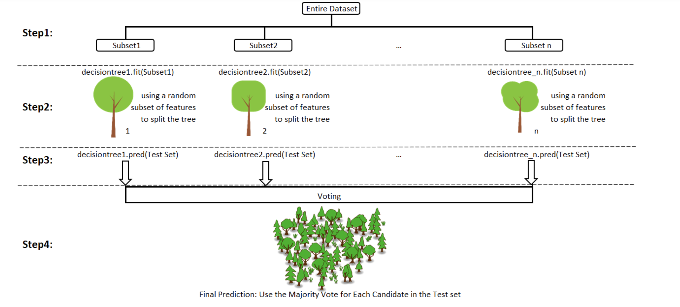
Classification
Random Forest

Slide 15
Thank You!
In our next session:
Application of Classification and Introduction to case study

